Slide 1
Numerical – Point Processing Operations

Slide 2
Problem - 1
Obtain the digital negative of the following 8-Bits Per Pixel (BPP) image.

Slide 3
Solution:
S = 255 – r

Slide 4
Solution:
S = 255 – r

Slide 5
Problem 2
Perform intensity (gray) level slicing on 3 BPP image. Let r1 = 3 and r2 = 5. Draw the modified image using with background and without background transformations.

Slide 6

Solution:
Without background:
S = $\left\{\begin{aligned}L−1 ;r1 ≤r ≤r2 \\ 0 ;Otherwise \end{aligned}\right.$

Slide 7
Solution:
Without background:
S = $\left\{\begin{aligned}L−1 ;r1 ≤r ≤r2 \\ 0 ;Otherwise \end{aligned}\right.$

Slide 8

With Background
S = $\left\{\begin{aligned}L−1 ;r1 ≤r ≤r2 \\ r ;Otherwise \end{aligned}\right.$

Slide 9
With Background
S = $\left\{\begin{aligned}L−1 ;r1 ≤r ≤r2 \\ r ;Otherwise \end{aligned}\right.$

Slide 10
Problem 3
Perform the following operations on the given 8 X 8 X 8 image.
Negative
Gray level slicing (r1 = 50; r2=170)
Dynamic Compression
Thresholding (Threshold value, a = 100)

Slide 12
Solution:
1 ->Digital Negative
S = L-1-r

Slide 13
Solution:
1 ->Digital Negative
S = L-1-r

Slide 14

2. Gray Level Slicing ->
Without Background
S = $\left\{\begin{aligned}L−1 ;r1 ≤r ≤r2 \\ 0 ;Otherwise \end{aligned}\right.$
r1 = 50; r2=170

Slide 15
2. Gray Level Slicing ->
Without Background
S = $\left\{\begin{aligned}L−1 ;r1 ≤r ≤r2 \\ 0 ;Otherwise \end{aligned}\right.$
r1 = 50; r2=170

Slide 16

With Background
S = $\left\{\begin{aligned}L−1 ;r1 ≤r ≤r2 \\ r ;Otherwise \end{aligned}\right.$
r1 = 50; r2=170

Slide 17
With Background
S = $\left\{\begin{aligned}L−1 ;r1 ≤r ≤r2 \\ r ;Otherwise \end{aligned}\right.$
r1 = 50; r2=170

Slide 18
3. Dynamic Range Compression ->
S = c * log(r +1)
Let C = 1

Slide 19
3. Dynamic Range Compression ->
S = c * log(r +1)
Let C = 1

Slide 20

5. Threshold
S = $\left\{\begin{aligned}L−1 ; r ≥a \\ 0;Otherwise \end{aligned}\right.$

Slide 21
5. Threshold
S = $\left\{\begin{aligned}L−1 ; r ≥a \\ 0;Otherwise \end{aligned}\right.$

Slide 22
Problem 4
The given image has 8 different gray levels. Plot this image using only 4 gray levels.

Slide 23
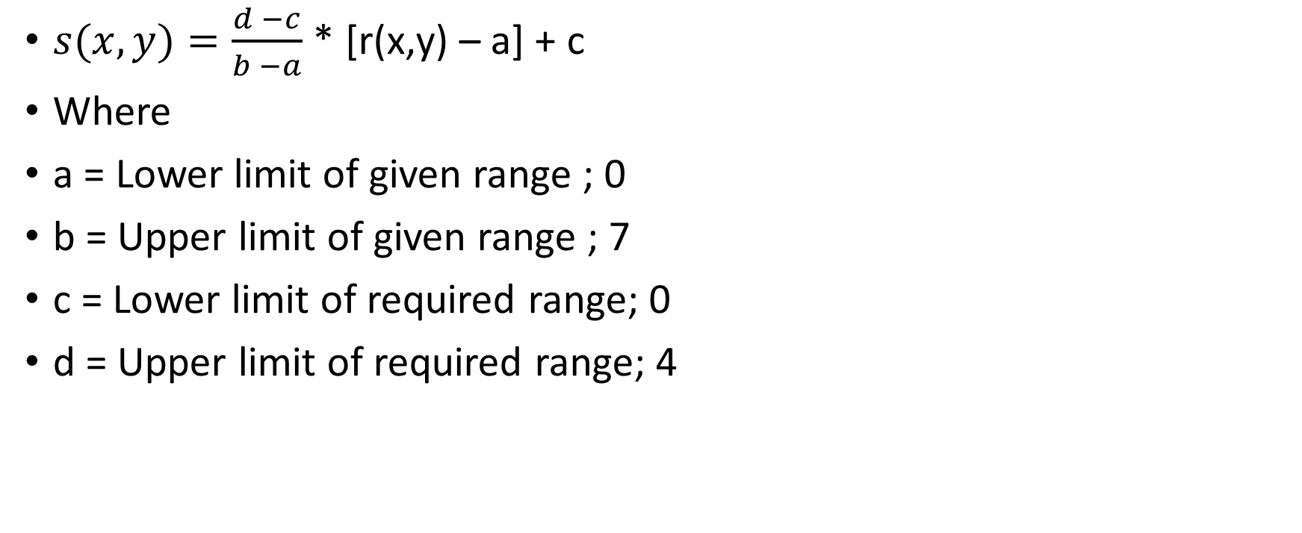
Solution:
$s(x,y)=\frac{d −c}{b −a}$ * [r(x,y) – a] + c
Where
a = Lower limit of given range ; 0
b = Upper limit of given range ; 7
c = Lower limit of required range; 0
d = Upper limit of required range; 4

Slide 24
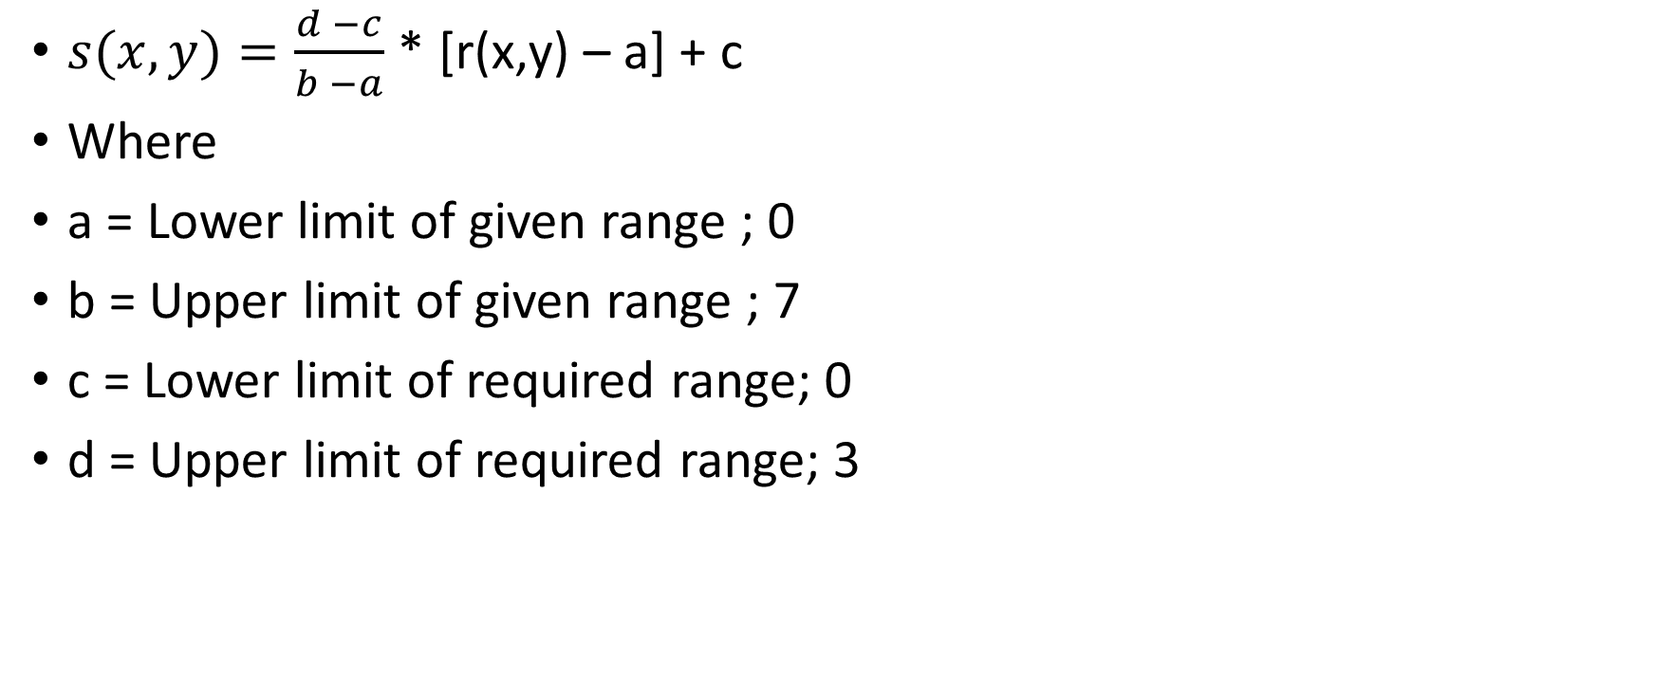
Solution:
$s(x,y)=\frac{d −c}{b −a}$ * [r(x,y) – a] + c
Where
a = Lower limit of given range ; 0
b = Upper limit of given range ; 7
c = Lower limit of required range; 0
d = Upper limit of required range; 3

